Slide 1
Week 3: Minimum Spanning Tree (MST)
Definition of MST (唔會form circle)
Generic MST algorithm
Kruskal's algorithm (最短edge開始，慢慢搵大搵上去)
Prim's algorithm (任意一點開始，每連下一個都對比之前個node + 新node 邊條edge最短就連邊條)

Slide 2
Graph
Subgraph
Tree: 1) connected, and
2) no cycle/unique path between two nodes/the no of edges=the no of nodes -1.
Forest:
a disjoint union of trees/a graph without cycles.

Slide 3
Problem: Rail Network

Slide 4
Naïve Approach
Expensive!

Slide 5
Better Approach
Minimize the total length of the railway connecting all the towns

Slide 6
Definition of MST
Spanning tree: Given a undirected and connected graph G=(V, E), a subgraph T of G is a spanning tree of G if
T is a tree and
T contains all the vertices (nodes) of G.

Slide 7
Given a connected and undirected graph G=(V,E), where each edge in E has a (nonnegative) weight (cost, or length),
a minimum spanning tree (MST) is a spanning tree with minimum total weight (cost, or length).

Slide 8
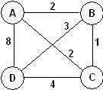
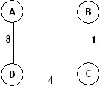
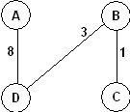
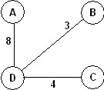
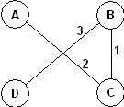
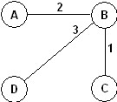
Minimum Spanning Tree: Example
Example: The graph
Has 16 spanning trees. Some are:
The graph has two minimum spanning trees, each with a length of 6:

Slide 9
Growing a MST(Generic Algorithm)
GENERIC_MST(G, w)
1 A:={}
2 while A does not form a spanning tree do
3 find an edge (u,v) that is safe for A
4 A:=A∪{(u,v)}
5 return A
Invariant: Set A is always a subset of some minimum spanning tree.
This property is called the invariant property.
An edge (u, v) is a safe edge for A if adding it to A does not destroy the invariant.
Basically, GENERIC_MST() says that “select the correct edges one by one until A becomes a minimum spanning tree.

Slide 10
Safe edge
We need some definitions and a theorem.
A cut (S,V-S) of an undirected graph G=(V,E) is a partition of V, where S is a subset of V.
An edge crosses the cut (S,V-S) if one of its endpoints is in S and the other is in V-S.
An edge is a light edge crossing a cut if its length is the shortest among all the edges crossing the cut.
S
V-S
Crossing edges

Slide 11
8
7
b
c
d
9
4
2
S↑
a
11
i
14
e
↑ S
4
7
6
10
7
V-S↓
h
g
f
↓ V-S
1
2
This figure shows a cut (S,V-S) of the graph.
S={a, b, d, e}, V-S={h, i, g, c, f}
The edge (d,c) and (a, h) are two light edges crossing the cut.

Slide 12
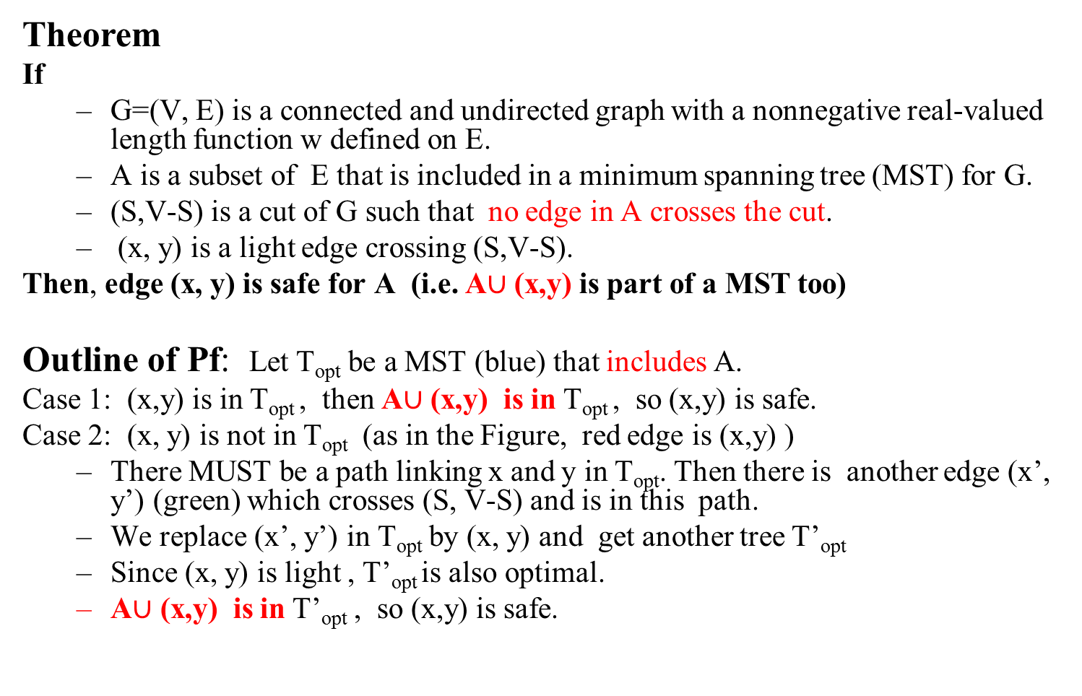
Theorem
If
G=(V, E) is a connected and undirected graph with a nonnegative real-valued length function w defined on E.
A is a subset of E that is included in a minimum spanning tree (MST) for G.
(S,V-S) is a cut of G such that no edge in A crosses the cut.
(x, y) is a light edge crossing (S,V-S).
Then, edge (x, y) is safe for A (i.e. A$∪$ (x,y) is part of a MST too)
Outline of Pf: Let T_{opt} be a MST (blue) that includes A.
Case 1: (x,y) is in T_{opt} , then A$∪$ (x,y) is in T_{opt} , so (x,y) is safe.
Case 2: (x, y) is not in T_{opt} (as in the Figure, red edge is (x,y) )
There MUST be a path linking x and y in T_{opt}. Then there is another edge (x’, y’) (green) which crosses (S, V-S) and is in this path.
We replace (x’, y’) in T_{opt} by (x, y) and get another tree T’_{opt}
Since (x, y) is light , T’_{opt} is also optimal.
A$∪$ (x,y) is in T’_{opt} , so (x,y) is safe.
x’
1
y’
1
2
1
1
1
y
1
x
1

Slide 13
Corollary
Let G=(V,E) be a connected, undirected graph with a real-valued weight function w defined on E.
Let A be a subset of E that is included in some minimum spanning tree for G. (A form a forest. See blue trees)
Let C be a connected component (tree) in the forest G_{A}=(V,A).
Let (u,v) be a light edge (shortest among all edges connecting C with other components) connecting C to some other component D in G_{A}.
Then, edge (u,v) is safe for A. (For Kruskal’s algorithm)
C
D

Slide 14
The algorithms of Kruskal and Prim
The two algorithms are elaborations of the generic algorithm.
They each use a specific rule to determine a safe edge in line 3 of GENERIC_MST.
In Kruskal's algorithm,
The set A is a forest.
The safe edge added to A is always a least-weight edge in the graph that connects two distinct components.
In Prim's algorithm,
The set A forms a single tree.
The safe edge added to A is always a least-weight edge connecting the tree to a vertex not in the tree.

Slide 15
Kruskal’s Algorithm

Slide 16
Kruskal's algorithm(basic part)
(Sort the edges in an increasing order)
A:={}
while E is not empty do {
take an edge (u, v) that is shortest in E
and delete it from E
if u and v are in different components then
add (u, v) to A
}
Note: each time a shortest edge in E is considered.

Slide 17
Graph
B
4
C
4
2
1
A
4
E
1
F
D
2
3
10
G
5
5
6
3
4
I
H
2
3
J

Slide 18
A
4
B
A
1
D
B
4
C
B
4
D
B
4
C
B
10
J
C
2
E
4
2
1
C
1
F
D
5
H
A
4
E
1
F
2
D
6
J
E
2
G
D
3
10
G
5
F
3
G
F
5
I
5
6
3
4
I
G
3
I
G
4
J
H
2
3
J
H
2
J
I
3
J

Slide 19
Sort Edges
(in reality they are placed in a priority queue - not sorted - but sorting them makes the algorithm easier to visualize)
1
1
A
D
C
F
C
2
E
E
2
G
B
4
C
H
2
J
F
3
G
4
2
1
G
3
I
I
3
J
A
4
E
1
F
2
A
4
B
B
4
D
D
3
10
G
5
B
4
C
G
4
J
5
6
3
4
I
F
5
I
D
5
H
H
2
3
J
D
6
J
B
10
J

Slide 20
Add Edge
1
1
A
D
C
F
C
2
E
E
2
G
B
4
C
H
2
J
F
3
G
4
2
1
G
3
I
I
3
J
A
4
E
1
F
2
A
4
B
B
4
D
D
3
10
G
5
B
4
C
G
4
J
5
6
3
4
I
F
5
I
D
5
H
H
2
3
J
D
6
J
B
10
J

Slide 21
Add Edge
1
1
A
D
C
F
C
2
E
E
2
G
B
4
C
H
2
J
F
3
G
4
2
1
G
3
I
I
3
J
A
4
E
1
F
2
A
4
B
B
4
D
D
3
10
G
5
B
4
C
G
4
J
5
6
3
4
I
F
5
I
D
5
H
H
2
3
J
D
6
J
B
10
J

Slide 22
Add Edge
1
1
A
D
C
F
C
2
E
E
2
G
B
4
C
H
2
J
F
3
G
4
2
1
G
3
I
I
3
J
A
4
E
1
F
2
A
4
B
B
4
D
D
3
10
G
5
B
4
C
G
4
J
5
6
3
4
I
F
5
I
D
5
H
H
2
3
J
D
6
J
B
10
J

Slide 23
Add Edge
1
1
A
D
C
F
C
2
E
E
2
G
B
4
C
H
2
J
F
3
G
4
2
1
G
3
I
I
3
J
A
4
E
1
F
2
A
4
B
B
4
D
D
3
10
G
5
B
4
C
G
4
J
5
6
3
4
I
F
5
I
D
5
H
H
2
3
J
D
6
J
B
10
J

Slide 24
Add Edge
1
1
A
D
C
F
C
2
E
E
2
G
B
4
C
H
2
J
F
3
G
4
2
1
G
3
I
I
3
J
A
4
E
1
F
2
A
4
B
B
4
D
D
3
10
G
5
B
4
C
G
4
J
5
6
3
4
I
F
5
I
D
5
H
H
2
3
J
D
6
J
B
10
J

Slide 25
Cycle
Don’t Add Edge
1
1
A
D
C
F
C
2
E
E
2
G
B
4
C
H
2
J
F
3
G
4
2
1
G
3
I
I
3
J
A
4
E
1
F
2
A
4
B
B
4
D
D
3
10
G
5
B
4
C
G
4
J
5
6
3
4
I
F
5
I
D
5
H
H
2
3
J
D
6
J
B
10
J

Slide 26
Add Edge
1
1
A
D
C
F
C
2
E
E
2
G
B
4
C
H
2
J
F
3
G
4
2
1
G
3
I
I
3
J
A
4
E
1
F
2
A
4
B
B
4
D
D
3
10
G
5
B
4
C
G
4
J
5
6
3
4
I
F
5
I
D
5
H
H
2
3
J
D
6
J
B
10
J

Slide 27
Add Edge
1
1
A
D
C
F
C
2
E
E
2
G
B
4
C
H
2
J
F
3
G
4
2
1
G
3
I
I
3
J
A
4
E
1
F
2
A
4
B
B
4
D
D
3
10
G
5
B
4
C
G
4
J
5
6
3
4
I
F
5
I
D
5
H
H
2
3
J
D
6
J
B
10
J

Slide 28
Add Edge
1
1
A
D
C
F
C
2
E
E
2
G
B
4
C
H
2
J
F
3
G
4
2
1
G
3
I
I
3
J
A
4
E
1
F
2
A
4
B
B
4
D
D
3
10
G
5
B
4
C
G
4
J
5
6
3
4
I
F
5
I
D
5
H
H
2
3
J
D
6
J
B
10
J

Slide 29
Cycle
Don’t Add Edge
1
1
A
D
C
F
C
2
E
E
2
G
B
4
C
H
2
J
F
3
G
4
2
1
G
3
I
I
3
J
A
4
E
1
F
2
A
4
B
B
4
D
D
3
10
G
5
B
4
C
G
4
J
5
6
3
4
I
F
5
I
D
5
H
H
2
3
J
D
6
J
B
10
J

Slide 30
Add Edge
1
1
A
D
C
F
C
2
E
E
2
G
B
4
C
H
2
J
F
3
G
4
2
1
G
3
I
I
3
J
A
4
E
1
F
2
A
4
B
B
4
D
D
3
10
G
5
B
4
C
G
4
J
5
6
3
4
I
F
5
I
D
5
H
H
2
3
J
D
6
J
B
10
J

Slide 31
Minimum Spanning Tree
Graph
B
4
C
4
B
C
4
4
2
1
2
1
A
E
A
4
1
F
E
F
1
D
2
2
D
3
10
G
G
5
3
5
6
3
4
I
I
H
H
2
3
3
J
2
J

Slide 32
Disjoint-Set
Keep a collection of sets S₁, S₂, .., S_{k},
Each S_{i} is a set, e,g, S₁={v₁, v₂, v₈}.
Three operations
Make-Set(x)-creates a new set whose only member is x.
Union(x, y) –unites the sets that contain x and y, say, S_{x} and S_{y}, into a new set that is the union of the two sets.
Find-Set(x)-returns a pointer to the representative of the set containing x.
Each operation takes O(log n) time.

Slide 33
Kruskal's algorithm
MST_KRUSKAL(G,w)
1 A:={}
2 for each vertex v in V[G]
3 do MAKE_SET(v)
4 sort the edges of E by nondecreasing weight w
5 for each edge (u,v) in E, in order by nondecreasing weight
6 do if FIND_SET(u) != FIND_SET(v)
7 then A:=A∪{(u,v)}
8 UNION(u,v)
return A

Slide 34
Our implementation uses a disjoint-set data structure to maintain several disjoint sets of elements.
Each set contains the vertices in a tree of the current forest.
The operation FIND_SET(u) returns a representative element from the set that contains u.
Thus, we can determine whether two vertices u and v belong to the same tree by testing whether FIND_SET(u)=FIND_SET(v).
The combining of trees is accomplished by the UNION procedure.
Running time O(|E| log (|E|)).

Slide 35
Prim’s Algorithm

Slide 36
Prim's algorithm(basic part)
MST_PRIM(G,w,r)
A={}
S:={r}
3. Q=V-{r};
4. while Q is not empty do {
5 take an edge (u, v) such that (1) u ∈S and v ∈ Q (v∉ S ) and
(u, v) is the shortest edge satisfying (1)
6 add (u, v) to A, add v to S and delete v from Q
}

Slide 37
Graph
B
4
C
4
2
1
A
4
E
1
F
D
2
3
10
G
5
5
6
3
4
I
H
2
3
J

Slide 38
Old Graph
Tree
B
4
C
4
B/4
4
C
2
1
4
2
1
A
4
E
1
F
A
4
E
F
1
D
2
3
10
D/1
2
3
G
5
10
G
5
5
6
3
5
6
3
4
I
4
H
I
3
H
2
J
2
3
J

Slide 39
Old Graph
Tree
B
4
C
4
B/4
4
C
2
1
4
2
1
A
4
E
1
F
A
4
E
F
1
D
2
3
10
D
2
3
G
5
10
G
5
5
6
3
5
6
3
4
I
4
H
I
3
H/5
2
J
2
3
J/6

Slide 40
Old Graph
Tree
B
4
C
4
B
4
C/4
2
1
4
2
1
A
4
E
1
F
A
4
E
F
1
D
2
3
10
D
2
3
G
5
10
G
5
5
6
3
5
6
3
4
I
4
H
I
3
H/5
2
J
2
3
J/6

Slide 41
Old Graph
Tree
B
4
C
4
B
4
C
2
1
4
2
1
A
4
E
1
F
A
4
E/2
F/1
1
D
2
3
10
D
2
3
G
5
10
G
5
5
6
3
5
6
3
4
I
4
H
I
3
H/5
2
J
2
3
J/6

Slide 42
Old Graph
Tree
B
4
C
4
B
4
C
2
1
4
2
1
A
4
E
1
F
A
4
E/2
F
1
D
2
3
10
D
2
3
G
5
10
G/3
5
5
6
3
5
6
3
4
I
4
H
I/5
3
H/5
2
J
2
3
J/6

Slide 43
Old Graph
Tree
B
4
C
4
B
4
C
2
1
4
2
1
A
4
E
1
F
A
4
E
F
1
D
2
3
10
D
2
3
G
5
10
G/2
5
5
6
3
5
6
3
4
I
4
H
I/5
3
H/5
2
J
2
3
J/6

Slide 44
Old Graph
Tree
B
4
C
4
B
4
C
2
1
4
2
1
A
4
E
1
F
A
4
E
F
1
D
2
3
10
D
2
3
G
5
10
G
5
5
6
3
5
6
3
4
I
4
H
I/3
3
H/5
2
J
2
3
J/4

Slide 45
Old Graph
Tree
B
4
C
4
B
4
C
2
1
4
2
1
A
4
E
1
F
A
4
E
F
1
D
2
3
10
D
2
3
G
5
10
G
5
5
6
3
5
6
3
4
I
4
H
I
3
H/5
2
J
2
3
J/3

Slide 46
Old Graph
Tree
B
4
C
4
B
4
C
2
1
4
2
1
A
4
E
1
F
A
4
E
F
1
D
2
3
10
D
2
3
G
5
10
G
5
5
6
3
5
6
3
4
I
4
H
I
3
H/2
2
J
2
3
J

Slide 47
Old Graph
Tree
B
4
C
4
B
4
C
2
1
4
2
1
A
4
E
1
F
A
4
E
F
1
D
2
3
10
D
2
3
G
5
10
G
5
5
6
3
5
6
3
4
I
4
H
I
3
H
2
J
2
3
J

Slide 48
Complete Graph
Minimum Spanning Tree
B
4
C
4
B
4
C
2
1
4
2
1
A
4
E
1
F
A
E
F
1
D
2
3
10
D
2
G
5
G
5
6
3
3
4
I
H
I
3
H
2
J
2
3
J

Slide 49

Prim's algorithm
MST_PRIM(G, w, r)
1 for each v in V do
key[v]:=∞, parent[v]:=NIL
A≔$∅$
4 key[r]:=0; parent[r]=NIL;
5 Q←(V, key) /* initialize Q.
6 while Q!={} do
7 u:=EXTRACT_MIN(Q); if parent[u]≠NIL, A:=A U (u, parent[u]).
8 for each v in Adj[u] do
9 if v in Q and w(u,v)<key[v]
10 then parent[v]:=u
k:=w(u,v)
Update(v,k)
Q (priority queue): contain all the vertices that have not
yet been included in the tree. V\S: vertices in the tree
Parent[v]: the nearest vertex in the tree to v
Key[v]: the length of edge (v, parent[v])
i.e. u is not r.
u: the nearest vertex in Q to the tree.
Remove u from Q, i.e., add u to the tree
v has an edge with u

Slide 50
After 1-5: The tree is empty. Q contains:
After one pass in while loop. The tree has one node A. Q is:
After second pass in while loop. The tree has two node A C, and one link (A,C), Q is:
B
4
Node | A | B | C | D | E
Key | 0 | inf | inf | inf | inf
Parent | NIL | NIL | NIL | NIL | NIL
A
4
1
C
10
Node | B | C | D | E
Key | 4 | 1 | inf | inf
Parent | A | A | NIL | NIL
5
6
D
2
E
Node | B | D | E
Key | 4 | 5 | 6
Parent | A | C | C
After third pass in while loop. The tree has two node A C, B and two links (A,C) and (A,B), Q is:
Node | E
Key | 2
Parent | D
Node | D | E
Key | 5 | 6
Parent | C | C

Slide 51
After 1-5: The tree is empty. Q contains:
After one pass in while loop. The tree has one node A. Q is:
After second pass in while loop. The tree has two node A C, and one link (A,C), Q is:
B
4
Node | A | B | C | D | E
Key | 0 | inf | inf | inf | inf
Parent | NIL | NIL | NIL | NIL | NIL
A
4
1
C
10
Node | B | C | D | E
Key | 4 | 1 | inf | inf
Parent | A | A | NIL | NIL
5
6
D
2
E
Node | B | D | E
Key | 4 | 5 | 6
Parent | A | C | C
After third pass in while loop. The tree has two node A C, B and two links (A,C) and (A,B), Q is:
Node | E
Key | 2
Parent | D
Node | D | E
Key | 5 | 6
Parent | C | C

Slide 52
priority queue Q: data structure containing n items: each item u has a key value key[u].
three important operations
EXTRACT-MIN(Q) –takes O(log (n)) times if there are n items in Q.
Insert an element (key u) into Q- takes O(log(n)) time.
Update(u, k): update the key value of element u to k - takes O (log (n)) time.

Slide 53
Grow the minimum spanning tree from the root vertex r.
Q is a priority queue, holding all vertices that are not in the tree now.
key[v]: the length of the shortest edge linking v with a vertex in the tree.
parent[v]: the parent of v in the tree. (v, partent[v]) is the shortest among all the edges linking v with a vertex in the tree.
When the algorithm terminates, Q is empty; the minimum spanning tree A for G is thus A={(v,parent[v]):v∈V-{r}}.
Running time: O(||E||log |V|).
Using Fibonacci heap structure to store Q, we can reduce the complexity to O(|E|+|V|log|V|) since Update(u, k) can be done in O(1) time for Fibonacci heap.

Slide 54
Summary
MST
Cut, safe edge.
Generic MST algorithm
Kruskal's algorithm
Prim's algorithm

Slide 55
Challenge Problem
Consider the problem of computing a maximum spanning tree, namely the spanning tree that maximizes the sum of edge costs. Do Prim and Kruskal’s algorithm work for this problem (assuming of course that we choose the crossing edge with maximum cost)?
Prove that for any weighted undirected graph such that the weights are distinct (no two edges have the same weight), the minimum spanning tree is unique.

